Slide 1
HIGH-RESOLUTION LAND COVER
LAND USE UPDATE for the
CHESAPEAKE BAY TMDL
KC Filippino, Senior Water Resources Planner
Hampton Roads Planning District Commission

Slide 2
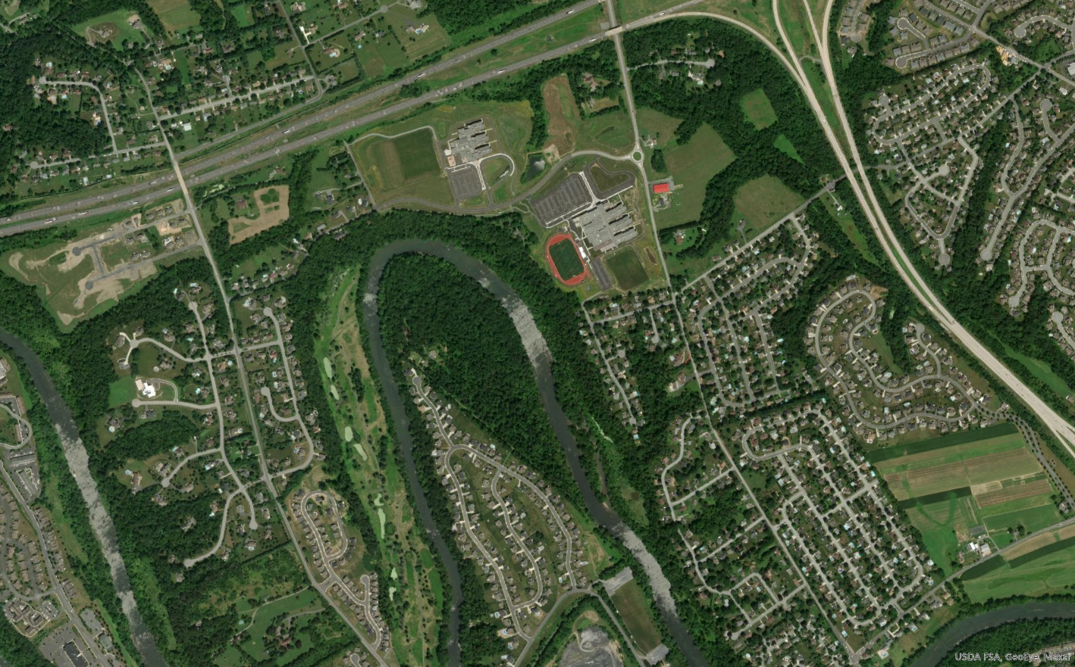
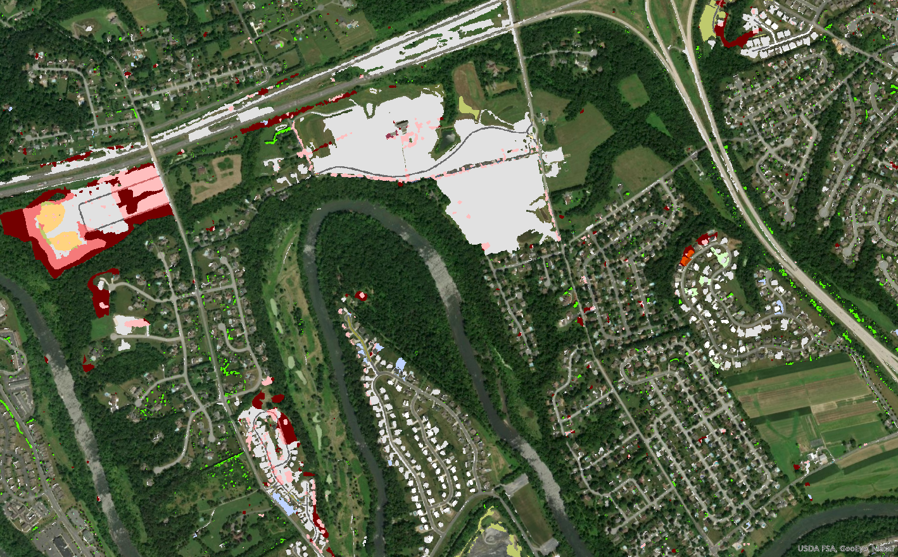
What are we talking about?
* History of land cover & land use at the Bay Program
* High-resolution land cover & land use update
* Data availability timeline
* Bay Program objectives
* How can these data products be useful to you?
2020
2013 - 2017
Images from P. Claggett Mgmt. Board meeting 2/11/21

Slide 3
UNDERSTANDING
THE HISTORY of DATA PRODUCTION
Adapted from P. Claggett Mgmt. Board meeting 2/11/21
2004 – 2016
Moderate-resolution (30-meter) land use/cover data coupled with Decennial Census of Population and Housing and USDA Agricultural Census data
2016– 2020
Produced and began using high-resolution (1-meter) land use/cover with 16 classes, from 2013/14 imagery
2020 – 2023
Produced and began using a second set of high-resolution land use/cover with 60 classes, from 2017/18 imagery and the first high-resolution land use change dataset: 2013/14 to 2017/18.
2023 and beyond
Continue to produce comparable high-resolution land use/cover data every four years through 2030.

Slide 4
Current Land Cover & Land Use Development
Chesapeake Conservancy
Conservation Innovation Center
Develop 1m Land Cover and Land Use datasets
Map and track BMPs
Delineate stream channels and ditches
Geospatial support
6-year Cooperative Agreement
  CBP, USGS, CIC & partners
4 Objectives

Slide 5
Current Land Cover & Land Use Development
Data development
Technical state & local review, input, approval
Jurisdictional approval
Model input
Partnership Approach
Sector-specific workgroups evaluations
Land Use Workgroup advises and vets datasets
Water Quality GIT approves for incorporation into model

Slide 6
Current Land Cover & Land Use Development
2017/18 Land Cover
Version 1: Reviewed, some corrections, informed version 1 land use
2017/18 Land Use
Version 1: Informed change product
2013/14 – 2017/18 Land Use Change
Version 1: Some review, corrections, informed CAST21
Version 2: Final product
Version 2: Final product
Version 2: Final product

Slide 7
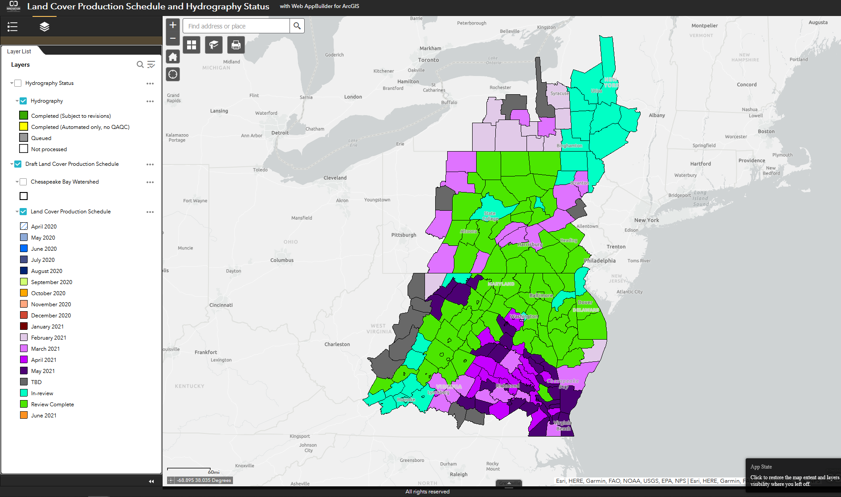
Chesapeake Conservancy Review Process
Reached out to all localities
Production schedule to inform who was coming up when
Main opportunity for local government review
Viewer developed to aid in review
https://cicgis.org/portal/apps/webappviewer/index.html?id=262ce838a60048e9a0f136d904639f66

Slide 8
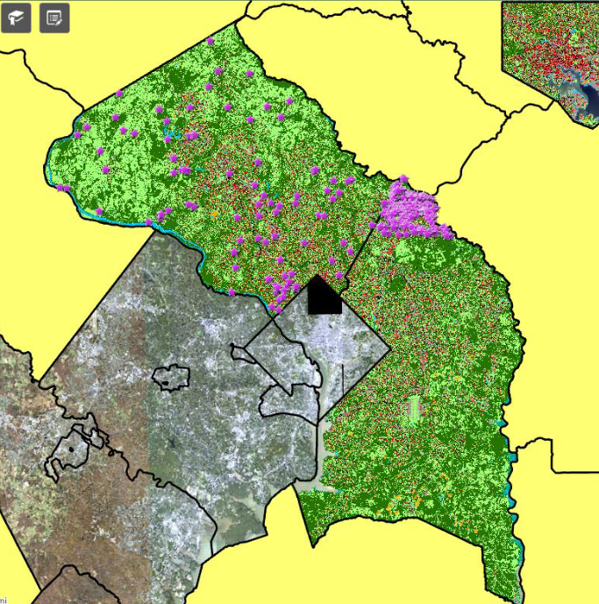
Land Cover Data Production & Review
Opportunity for detailed review of land cover data by all 206 localities in Bay watershed
Consistent process across localities and jurisdictions
Systematic errors led to under- or over-classification of certain land cover/use
  Agriculture, turf grass, wetlands, bare shore, etc.
Developed a Version 1 Land Cover to inform Land Use

Slide 9
Land Cover
Adapted from R. Soobitsky webinar, 2021
Water, Impervious surfaces, trees, wetlands, structures, herbaceous, shrubland, tree canopy, etc.
Land Use
Forest
Water
- Lentic
Forest (>= 1 acre, 240-ft
width)
Other Tree Canopy
Harvested Forest (<= 3 years)
Natural Succession
Developed
- Impervious
Estuary
Lakes and Ponds
Roads
Structures
Other Impervious (Parking Lots, Driveways, Railroads, etc.)
Tree Canopy over Impervious
- Pervious
Wetlands and Water Margins
Production
- Agriculture
Tidal
Riverine (non-tidal)
Terrene/Isolated (non-tidal)
Bare Shore
Turf Grass
Bare Developed
Suspended Succession
Tree Canopy over Turf Grass
Cropland
Pasture/Hay
Orchard/Vineyard
Extractive (active mines)
Solar Fields
Impervious
Pervious

Slide 10
Land Use Development
14 prototype counties chosen
Represented a range of land use types to evaluate
Opportunity to test decision rules for conversion of land cover to land use
Used to inform change detection and review process
Automate for remaining Bay watershed localities

Slide 11
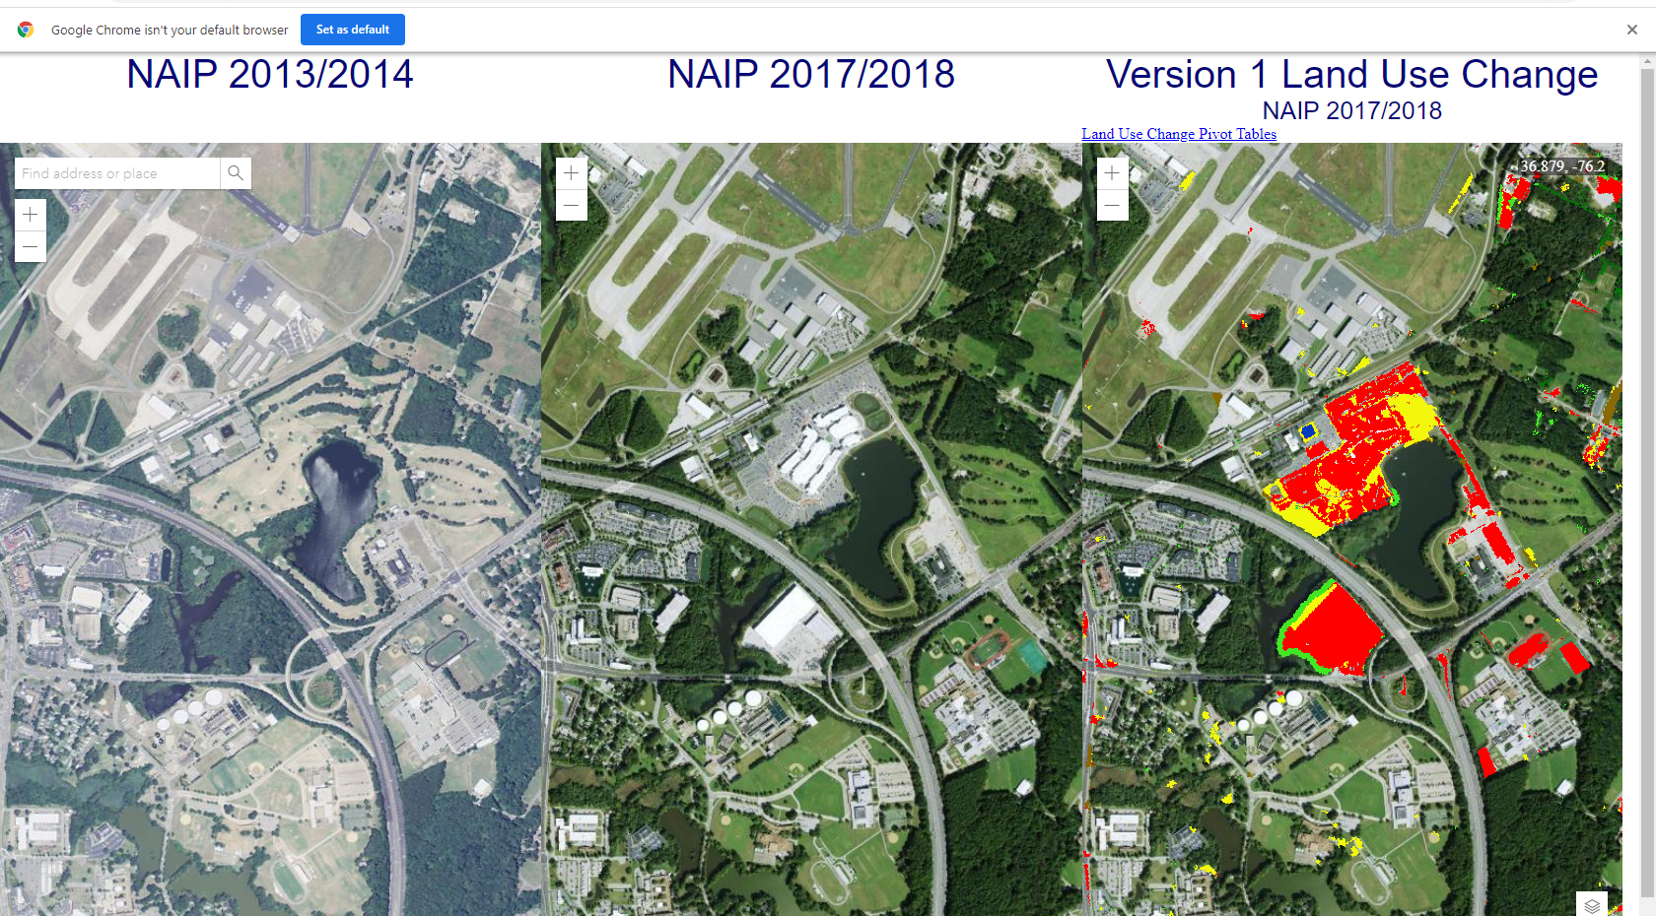
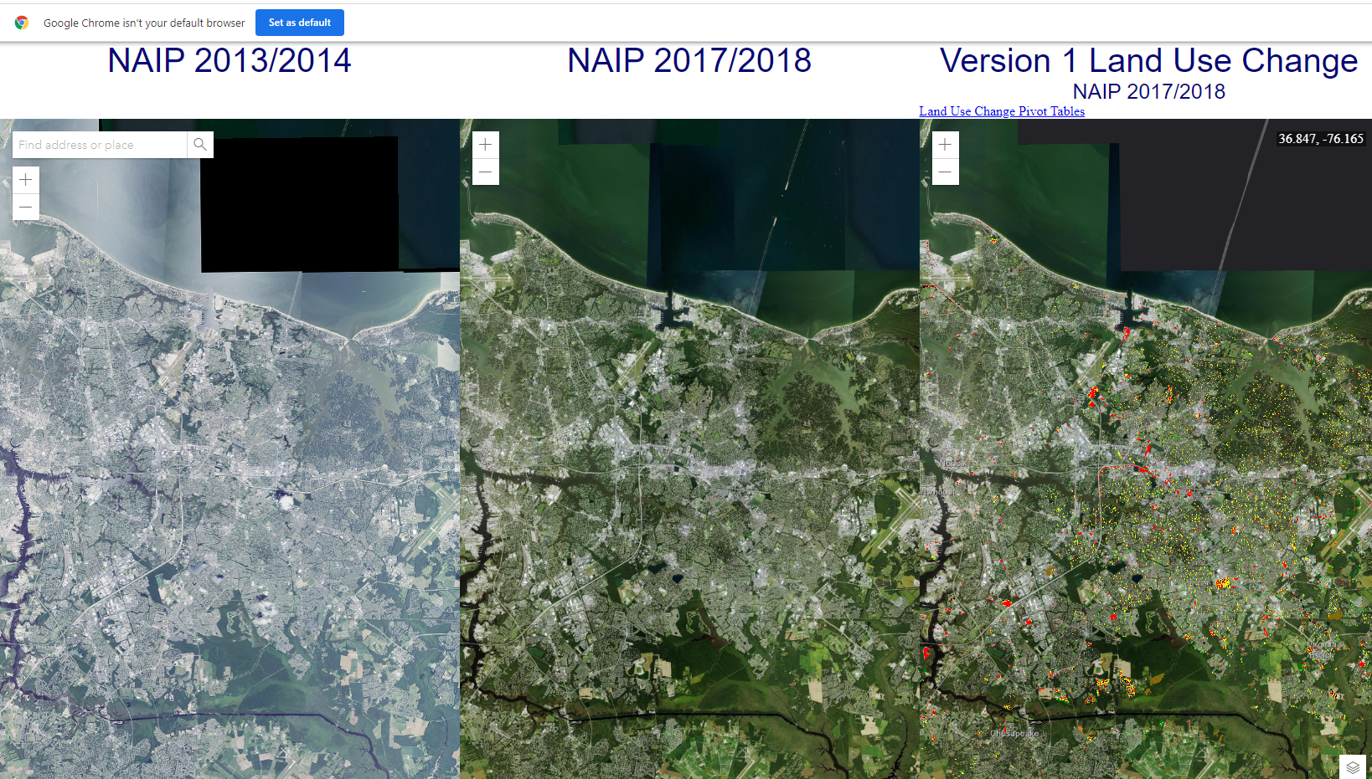
Land Use Change Analysis
Viewer aided in capturing Land Use change from 2013/14 to 2017/18
Discrepancies and inaccuracies documented
Final (Version 2) of land use change being developed
Forest to impervious non-roads
Forest to tree canopy over turf grass
Mixed open to turf grass

Slide 12
Data Availability Timeline
Nov. 2021
Incorporate Version 1 of 2013/14 to 2017/18 Land Use change into CAST21 for modeling purposes
Feb. 2022
Public versions (V2) published
June 2022
Accuracy assessments and lessons learned made available
Final Data Products:
V2 Land Cover (2017/18)
V2 Land Cover Change (2013/14 – 2017/18)
V2 Land Use (2017/18)
V2 Land Use Change (2013/14 – 2017/18)
Simultaneously, gathering new data to repeat process on a shorter time scale for CAST23

Slide 13
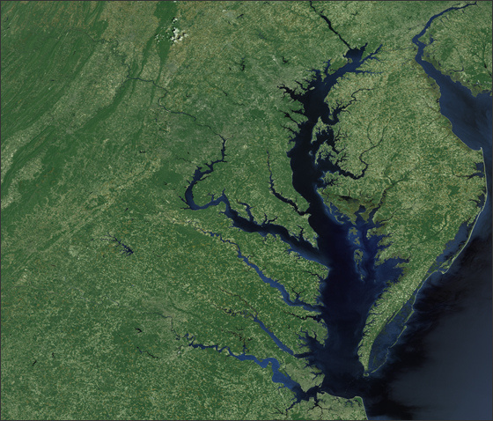
Big picture CBP data objectives
1. Measure rate of farmland, forest and wetland conversion, and the extent and rate of change in impervious surface coverage.
2. Quantify the potential impacts of land conversion to water quality, healthy watersheds and communities.
3. Launch a public awareness campaign to share this information with citizens, local governments, elected officials and stakeholders.
Expectations and outcomes as presented by P. Claggett to Management board

Slide 14
Uses in Hampton Roads & Beyond
Impervious cover calculations to inform policy decisions for using Intensity, Duration, & Frequency safety factors
Development patterns, change over time to inform loading rate estimates
Tree canopy assessments
Regional conservation corridors, resilience, and flooding evaluations
Chesapeake Conservancy already has long list of use cases

Slide 15
What about your local or regional needs?
How is this data meaningful to you?
What can you do with high-resolution, 1-m, land use/land cover data?
How often would you need it to be updated?
Would it replace the need for locality’s to do this on their own?
How should data be delivered? (Viewers, spreadsheets, GIS, etc.)
More details about the multi-year effort and potential outcomes can be found at the Chesapeake Conservancy’s website.

