Slide 1
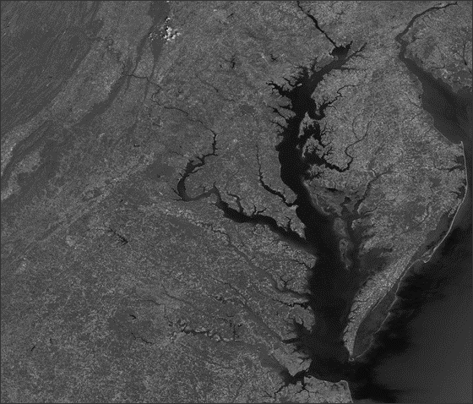


KC Filippino, Hampton Roads Planning District Commission & Mike Barbachem, Hazen & Sawyer
Retrofitting Businesses and Industries for the Bay TMDL
Work funded by the National Fish and Wildlife Foundation (NFWF) , Chesapeake Bay Small Watershed Planning Grant

Slide 2
Part 1: Background & Purpose
Part 3: Findings
Outline
07
Industrial partners
01
Hampton Roads & what makes up our Bay loads
08
BMPs and incentives
09
More work to be done
02
Phase III WIP commitments
03
Unregulated vs regulated
Part 2: Methods
04
Mapping exercise
05
Scoring and ranking
06
Communication

Slide 3
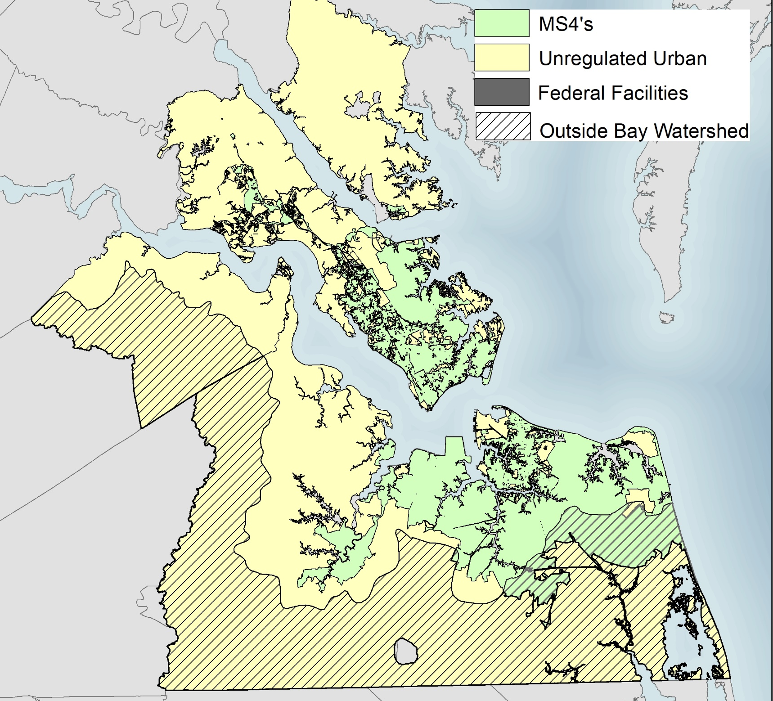
Regional Collaboration
1 of 22 Planning District Commissions in VA
17 localities, 15 in the Bay watershed
6 Phase I and 5 Phase II MS4 permittees, many non-traditional permittees
3 Soil Water Conservation Districts
1 regional wastewater entity
Several federal facilities
Multiple environmental NGOs
Support from consultants and academics

Slide 4
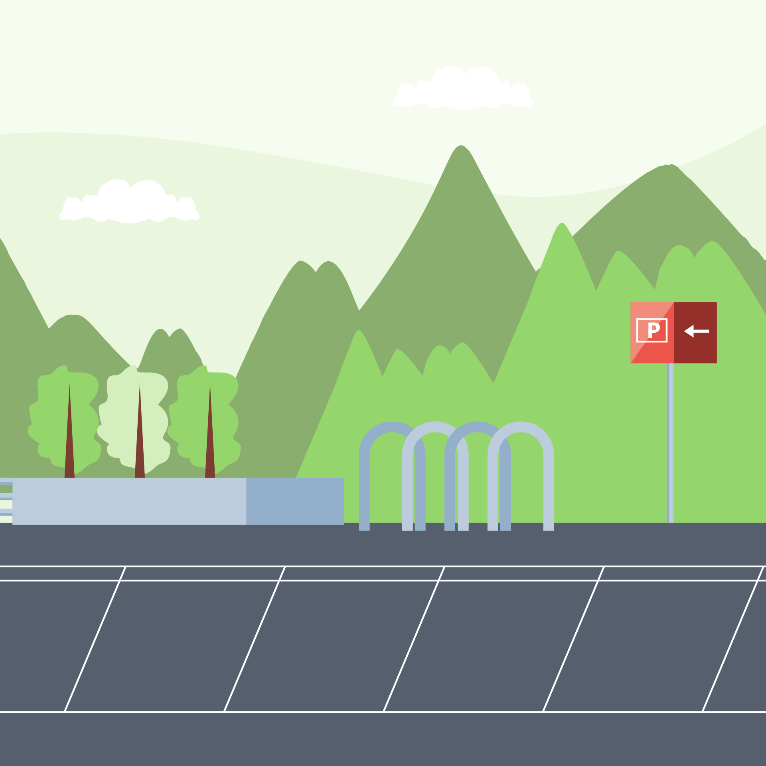


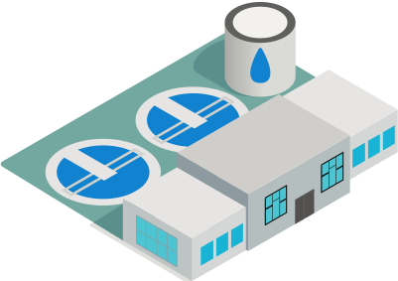
What makes up Bay loads in Hampton Roads?
Nitrogen & Phosphorus contributions as of 2020
Regulated Developed
18% TN; 19% TP
For the Developed sector only, Unregulated Developed
accounts for:
40% of the acreage
35% of the developed TN load
33% of the developed TP load
How will those reductions be achieved?
Unregulated Developed
10% TN; 9% TP
Natural lands = forest, wetlands, buffers:
10% TN; 27% TP
Agriculture:
8% TN; 2% TP
Wastewater & Septic:
55% TN; 42% TP

Slide 5
Purpose: Address Phase III WIP needs
Bay TMDL success dependent upon voluntary and mandatory reductions
In Hampton Roads, wastewater and regulated stormwater are responsible for regulated reductions
40% of the developed land in the region is unregulated
The Phase III WIP called on unregulated developed to make voluntary reductions
HRPDC applied for NFWF funding to find willing partners and explore options for BMP implementation and reporting

Slide 6



Industry partners
Regulated for discharge through VA Pollution Discharge Elimination System (VPDES) permits
Bay TMDL requirements are for monitoring only
Many have stormwater runoff directly to waterways outside of any MS4 system
Many are part of existing stewardship programs and already doing great things

Slide 7



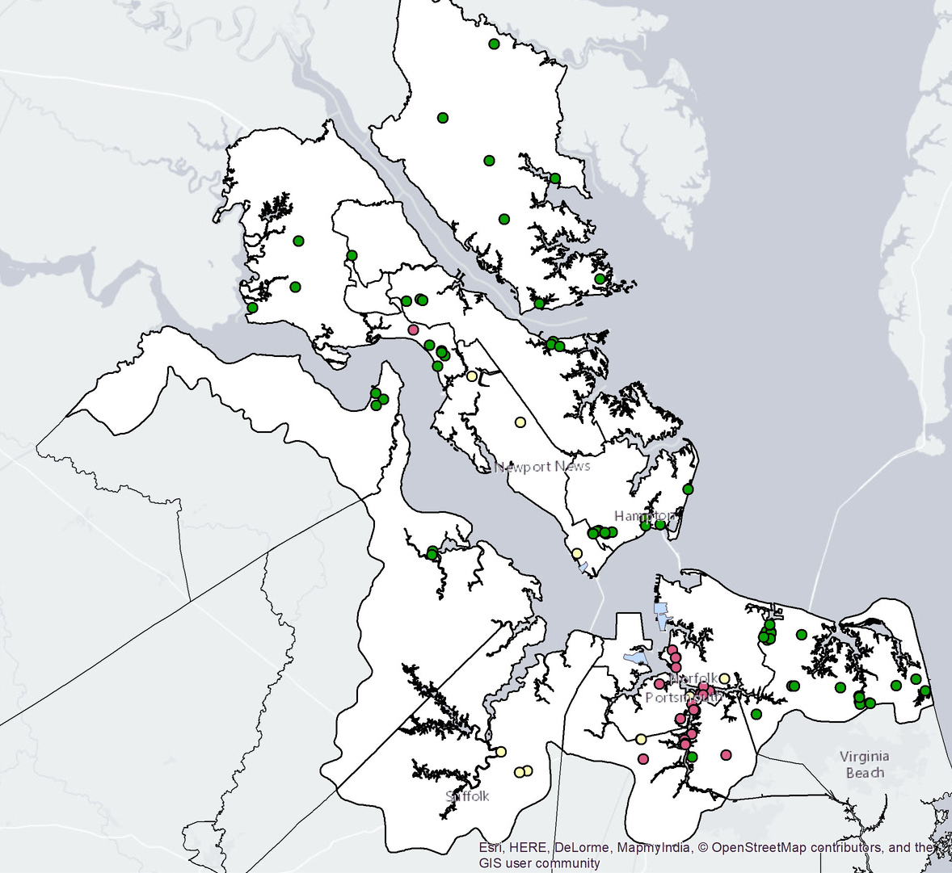
Methods
1) Map industrial partners using VPDES permit information, floodplain boundaries, shoreline location, stewardship participation
2) Rank potential partners
3) Engage partners and develop plans

Slide 8
Scoring Matrix
Does it flood? Are they stewards already? Do they have shorelines that drain directly to local waters?

Slide 9
Lots of Opportunities
Locality | Heat Map Categories & # of parcels
 | 0, 0.5, 1.a, 1.b | 1.5, 2.a, 2.b | 2.5, 3.a, 3.b | 3.5, 4.a, 4.b | 4.5, 5.a, 5.b | 5.5, 6
Chesapeake | 2,261 | 356 | 2 |  | 99 | 7
Franklin | 204 | 294
Gloucester County | 228 | 18 |  |  | 2
Hampton | 1,501 | 374 | 3 |  | 375 | 2
Isle of Wight County | 77 | 69 | 1 |  | 6
James City County | 1,914 | 18 |  |  | 9 | 1
Newport News | 2,210 | 140 |  |  | 22 | 1
Norfolk | 4,143 | 1,288 | 4 |  | 173 | 9
Poquoson | 5 | 25 |  |  | 6
Portsmouth | 1,510 | 444 | 1 |  | 44 | 1
Smithfield | 19 | 2 |  |  | 4 | 1
Southampton County | 168 | 29
Suffolk | 1,439 | 85 |  |  | 33
Virginia Beach | 2,975 | 459 | 6 |  | 87 | 3
Williamsburg | 276 | 1
Windsor | 20 | 6
York County | 1,013 | 35 | 1 |  | 33 | 2
Total | 19,963 | 3,643 | 18 | 0 | 893 | 27

Slide 10

Survey partners
What are you already doing? Interested in more? Care to report?
- Conduct email questionnaire
- Cold-calls
- Site visit

Slide 11



Findings
Large pool of potential partners
BMPs and incentives
More work to be done

Slide 12
Large pool of potential partners
20%
Reached 5 out of 27 industrial partners that ranked high
Potential to impact thousands of acres

Slide 13
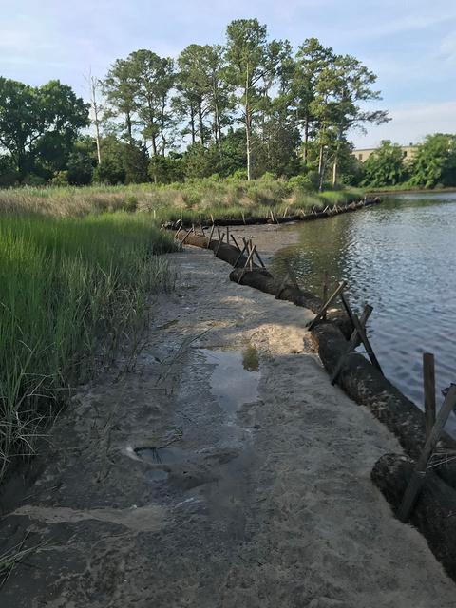
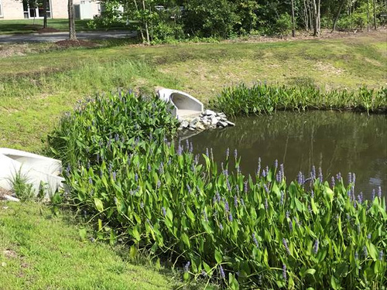
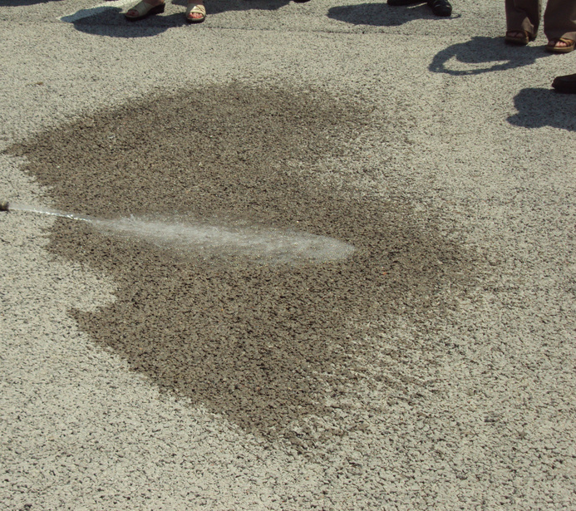
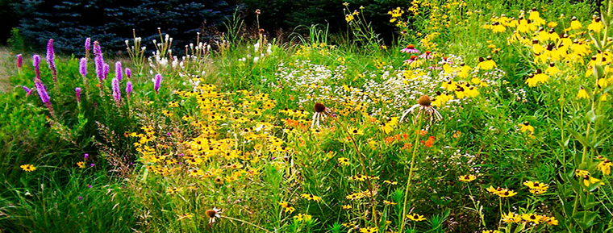
BMPs can be implemented & reported
No problem with reporting existing BMPS - which aren't for Bay TMDL compliance - and implementing new ones for multiple benefits
Land Cover Practices preferred
Living shorelines
Pond retrofits
Conservation landscaping
Impervious pavement removal
Maintenance is key
Verify through windshield surveys

Slide 14



Incentives Identified
BEING PART OF A STEWARDSHIP OPPORTUNITY & TEAM BUILDING
ACHIEVING COMPLIANCE FOR OTHER ISSUES & ADDRESSING FLOOD CONCERNS
FEE REDUCTIONS AND MORE FUNDING SOURCES

Slide 15

More work to be done
Only had detailed conversations with 5 partners
Need to cast a wider net and develop contact lists
Incentives and achieving multiple benefits are keys to success
Potential for pilot implementation projects and partnerships

Slide 16



Proposing Pilot
Implement BMPs for Bay TMDL and stewardship benefits
Report, track, and verify BMPs
Grow a coalition of the willing

Slide 17
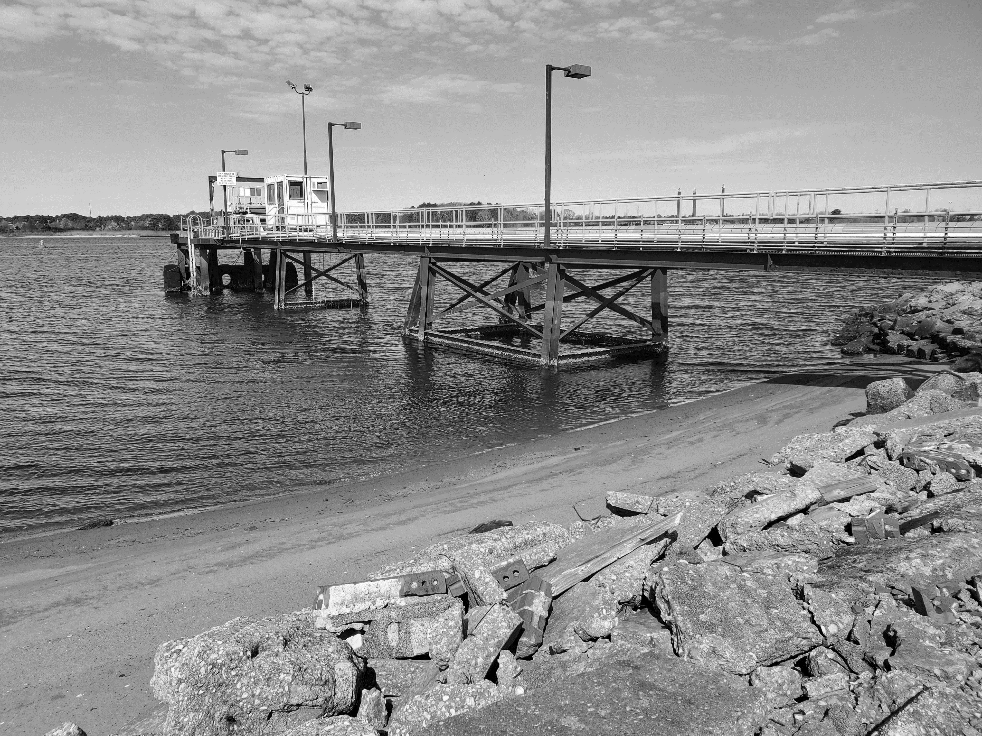
Stay Tuned...
KC Filippino, kfilippino@hrpdcva.gov

