Slide 1

Presented to the Hampton Roads Planning District Commission
2017 Regional Economic Forecast
Greg Grootendorst
Chief Economist
January 19, 2017
Agenda Item #8
2012 REGIONAL FORECAST

Slide 2
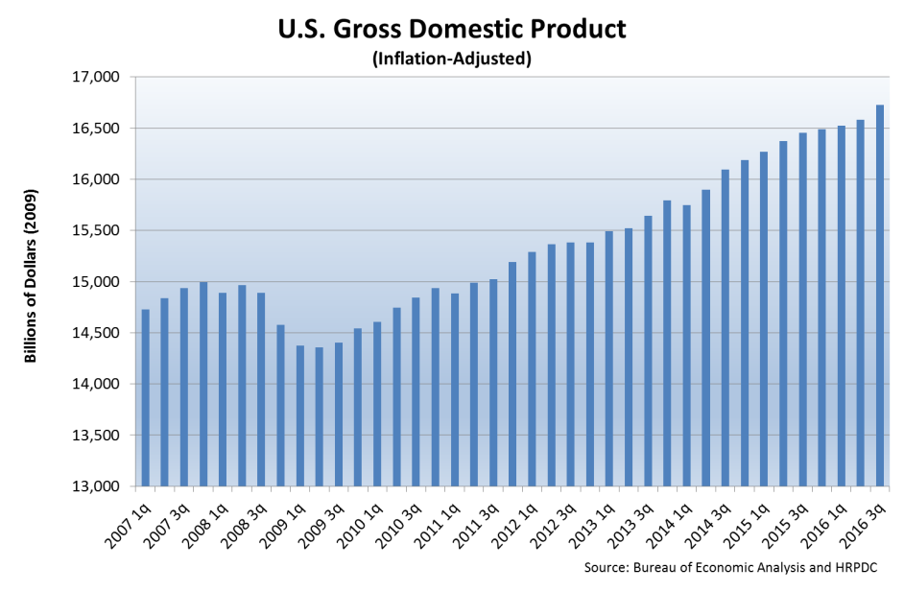
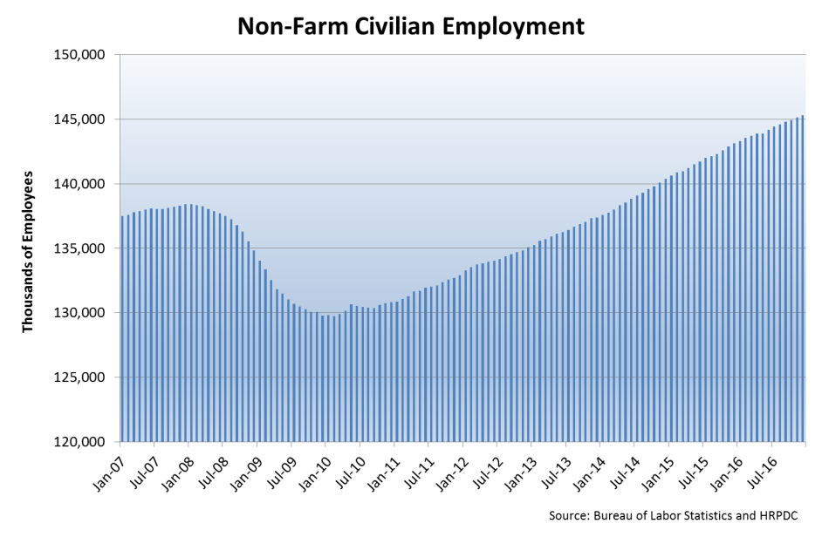
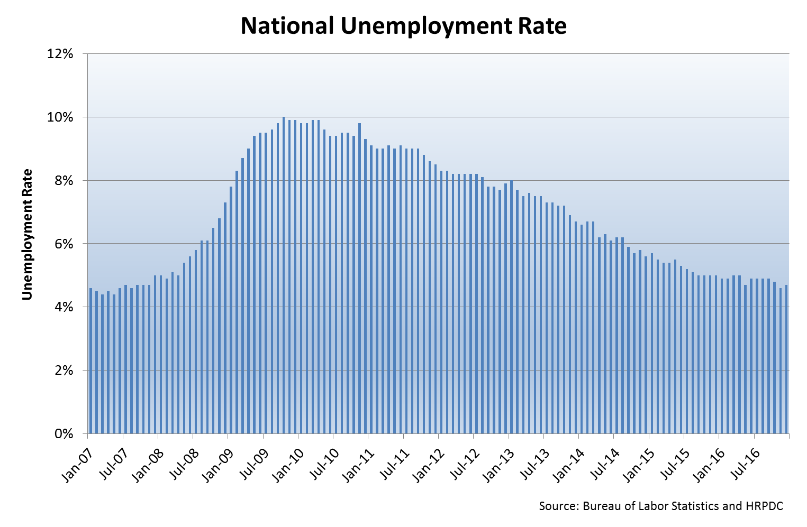
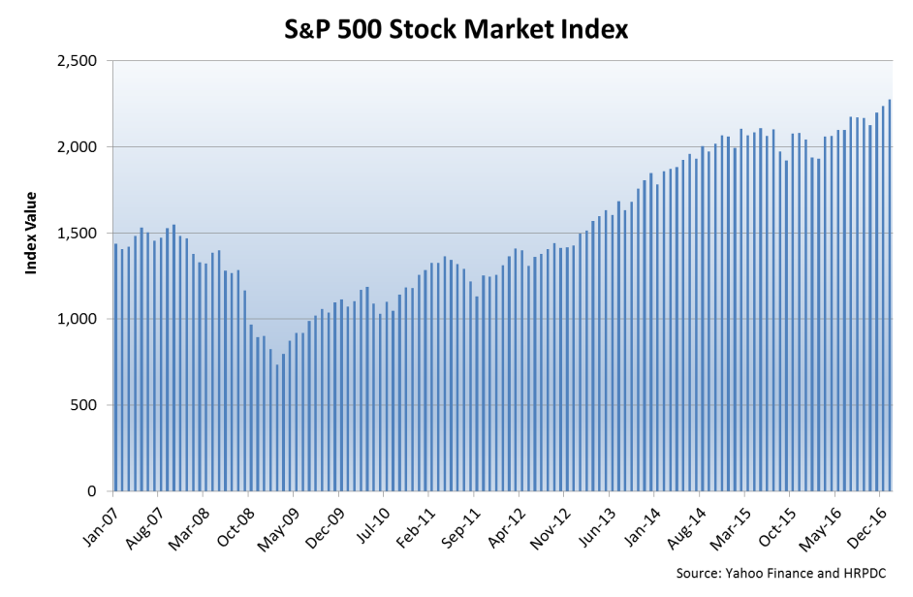

National Indicators
Hampton Roads 2017 Regional Economic Forecast
2

Slide 3
Civilian Employment Decline and Recovery
Source: Bureau of Labor Statistics, HRPDC
Hampton Roads 2017 Regional Economic Forecast
3

Slide 4
Hampton Roads Employment Change: Nov '07 - Nov '16
Source: Bureau of Labor Statistics, HRPDC
Hampton Roads 2017 Regional Economic Forecast
4

Slide 5
Hampton Roads Employment Change: Nov '15 - Nov '16
Source: Bureau of Labor Statistics, HRPDC
Hampton Roads 2017 Regional Economic Forecast
5

Slide 6
Initial Unemployment Claims in Hampton Roads (Seasonally Adjusted)
Source: Virginia Employment Commission, HRPDC
Hampton Roads 2017 Regional Economic Forecast
6

Slide 7
U.S., Virginia, & Hampton Roads Unemployment Rate (Seasonally Adjusted)
Source: Bureau of Labor Statistics, HRPDC
Hampton Roads 2017 Regional Economic Forecast
7

Slide 8
Labor Force & Participation in Hampton Roads
Source: Bureau of Labor Statistics, Bureau of Economic Analysis, the Weldon Cooper Center, and HRPDC
Hampton Roads 2017 Regional Economic Forecast
8

Slide 9
FHFA Home Price Index Growth in Hampton Roads, Virginia, and the U.S.
Source: Federal Housing Finance Agency, HRPDC
Hampton Roads 2017 Regional Economic Forecast
9

Slide 10
Foreclosures in Hampton Roads
Source: Zillow.com and HRPDC
Hampton Roads 2017 Regional Economic Forecast
10

Slide 11
Value of Single Family Building Permits in Hampton Roads
Source: U.S. Census Bureau and HRPDC
Hampton Roads 2017 Regional Economic Forecast
11

Slide 12
Indexed Taxable Retail Sales
Source: Virginia Department of Taxation and HRPDC
Hampton Roads 2017 Regional Economic Forecast
12

Slide 13
Auto and Truck Sales in Hampton Roads
Source: Virginia Automobile Dealers Association and HRPDC
Hampton Roads 2017 Regional Economic Forecast
13

Slide 14
Taxable Accommodations in HR
Source: Virginia Department of Taxation and HRPDC
Hampton Roads 2017 Regional Economic Forecast
14

Slide 15
Hampton Roads Employment by Type
1969
26.4%
37.2%
Year:
<-- Military Personnel as a % of Total Employment -->
<-- ALL Federal Employment as a % of Total Employment -->
2015
8.3%
13.8%
Sources: Bureau of Economic Analysis and HRPDC
Hampton Roads 2017 Regional Economic Forecast
15

Slide 16
Military Personnel in Hampton Roads
Sources: Bureau of Economic Analysis and HRPDC
Hampton Roads 2017 Regional Economic Forecast
16

Slide 17
Defense Spending in Hampton Roads Inflation-Adjusted
Sources: HRPDC
Hampton Roads 2017 Regional Economic Forecast
17

Slide 18
DoD Budget & Expenditures
Source: HRPDC
Hampton Roads 2017 Regional Economic Forecast
18

Slide 19
Hampton Roads: 2000 vs. 2015
HR Rank in the Comparable Metro Areas
Highest Value
Lowest Value
9.4 %
% Growth in Population
1
25
36
8.0%
% Growth in Employment
1
24
36
-0.9%
% Growth in Retail Employment
1
19
36
6.3%
% Growth in the Private Sector
1
19
36
6.4%
% Change in the Number of People with a College Degree
1
15
36
75.3%
% Change in Home Prices
1
7
36
65.7%
% Change in Per Capita Income
1
4
36
Hampton Roads 2017 Regional Economic Forecast
19

Slide 20
The Year Ahead…
The Good:
The Bad:
DoD pay increase
Continued growth in the national economy
Consumer spending is strong
Low energy prices
Corporate investment is up
Interest rates remain low
Interest rates are edging up
Federal spending remains tight
Region’s housing market remains soft
Dollar is high
Weak productivity growth
Slow growth outside of the U.S.
Hampton Roads 2017 Regional Economic Forecast
20

Slide 21
Annualized Percent Change in Gross Domestic Product
Source: Blue Chip Economic Indicators and HRPDC
Hampton Roads 2017 Regional Economic Forecast
21

Slide 22
Employment & Recessions in the U.S.
Source: Federal Reserve Bank, Bureau of Labor Statistics and HRPDC
Hampton Roads 2017 Regional Economic Forecast
22

Slide 23
2017 HRPDC Forecast
Hampton Roads 2017 Regional Economic Forecast
23

Slide 24
Discussion
Greg Grootendorst
HRPDC Chief Economist
ggrootendorst@hrpdcva.gov
Hampton Roads 2017 Regional Economic Forecast
24

